Slide 1




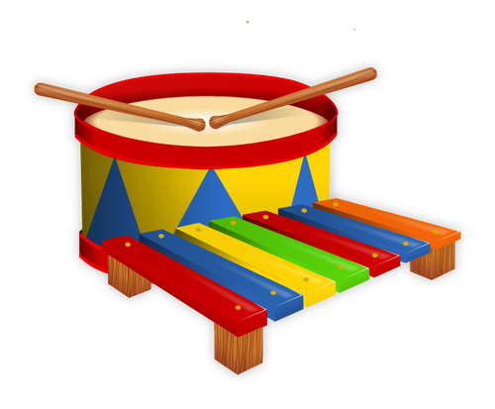

Welcome to the Music GOOGLE Classroom!
I am so glad you are here!

Slide 2

Let’s take a look at
the music GOOGLE classroom rules!
Welcome to the Music GOOGLE Classroom!
I am so glad you are here!

Slide 3
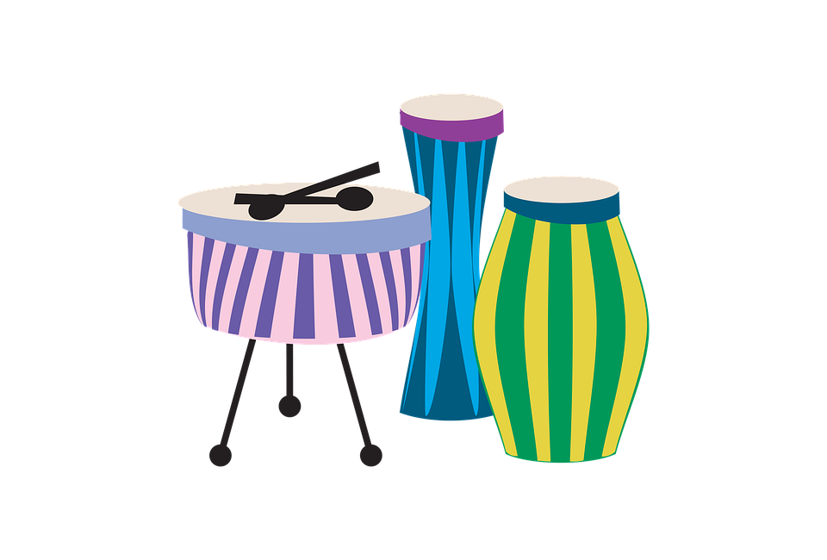

RULE #1
Be on time!
Music GOOGLE Class time begins at 1pm daily

Slide 4
RULE #2
MUTE your mic
and
turn your camera ON

Slide 5
RULE #3
No food, pets or other distractions in the
Music GOOGLE Classroom

Slide 6
RULE #4
Stay in one place and face the camera

Slide 7
RULE #5
Always be respectful to your teacher and classmates

Slide 8
RULE #6
Pay attention
Listen and follow directions quickly

Slide 9
RULE #7
Always do your
best work!

Slide 10
Let’s have a great time together in
the music GOOGLE classroom!
Welcome to the Music GOOGLE Classroom!
I am so glad you are here!

